Slide 1

Seasonal Attendance at Glacier National Park
-Douglas Lindsey

Slide 2

About Me
B.A. in Philosophy from Virginia Tech
B.S. in Engineering from Embry-Riddle Aeronautical University
M.P.S in Psychology of Leadership from Penn State
Currently working on M.S. in Aerospace Engineering from Embry-Riddle Aeronautical University
U.S. Army Infantry Veteran
Avid Virginia Tech football fan (Go Hokies!), hoping we don't get left out of the ongoing college realignment
Looking for a career shift to Data Analyst/Data Scientist Role
Hoping to work in Defense/Aerospace industry

Slide 3
Capstone Goal
Use machine learning time series forecasting to predict when the best time to visit Glacier National Park

Slide 4
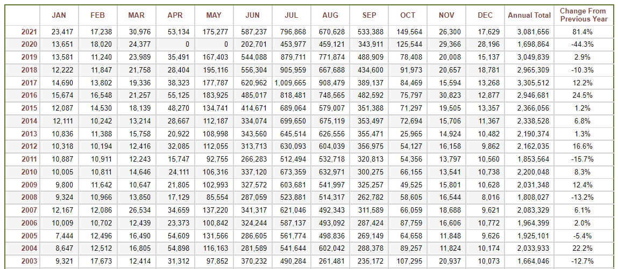
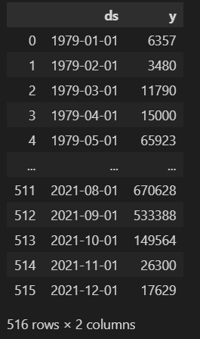
Data Familiarization and Manipulation

Slide 5
Facebook Prophet
“Prophet” is an open-sourced library available on R or Python which helps users analyze and forecast time-series values released in 2017

Slide 6
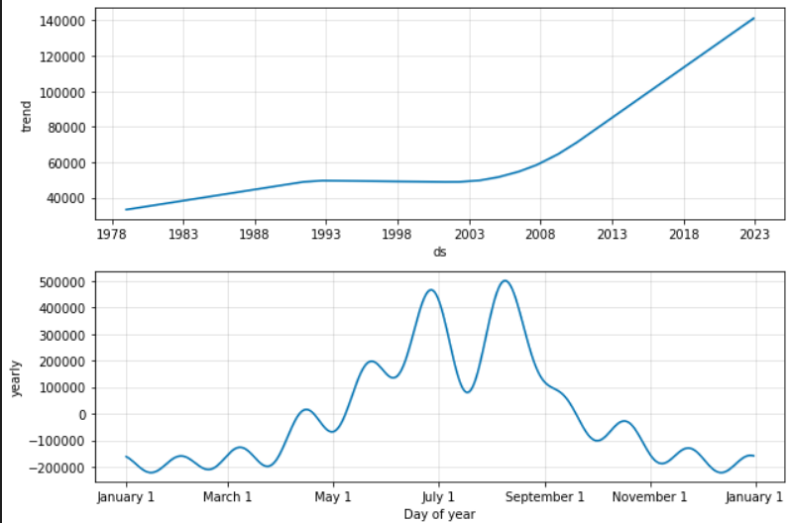
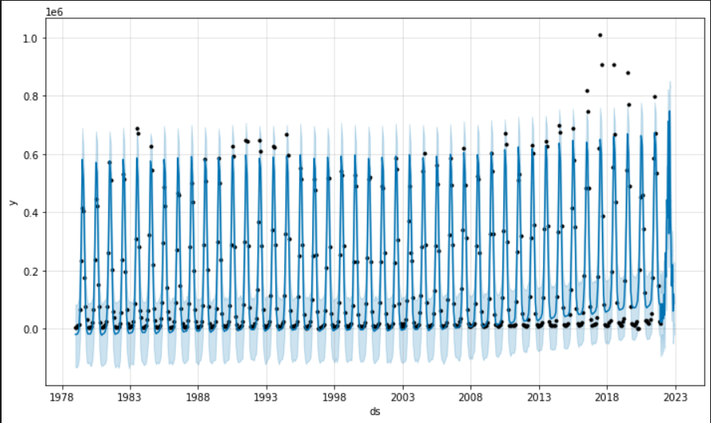
Facebook Prophet – Time Series Prediction

Slide 7
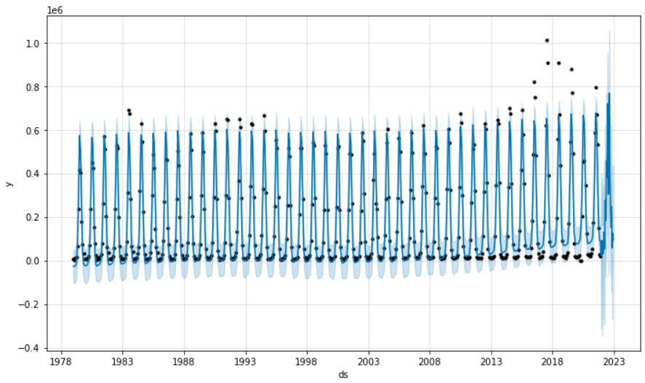
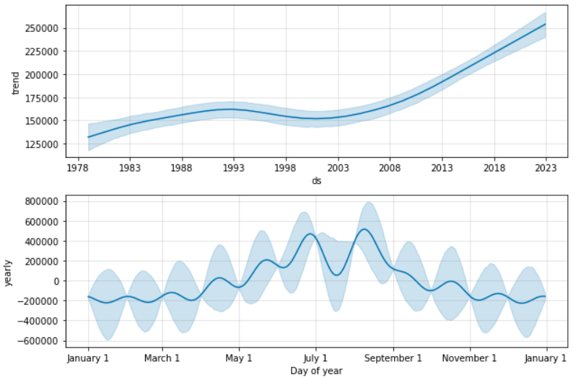
Prediction With Potential Variance Shown

Slide 8
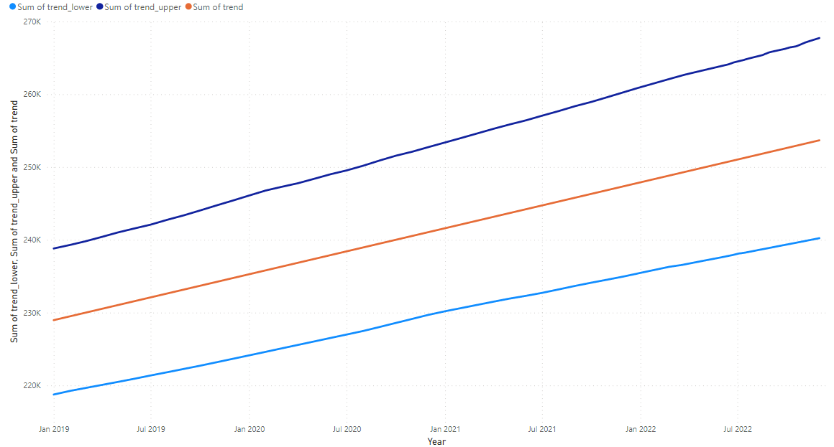
Annual Attendance Potential Variance

Slide 9
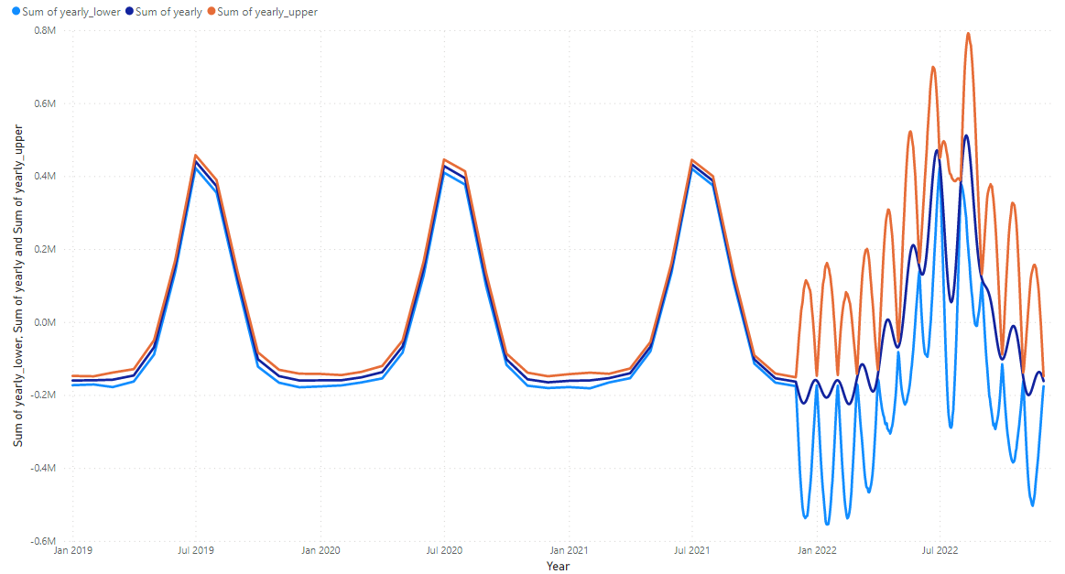
Monthly Attendance Potential Variance

Slide 10
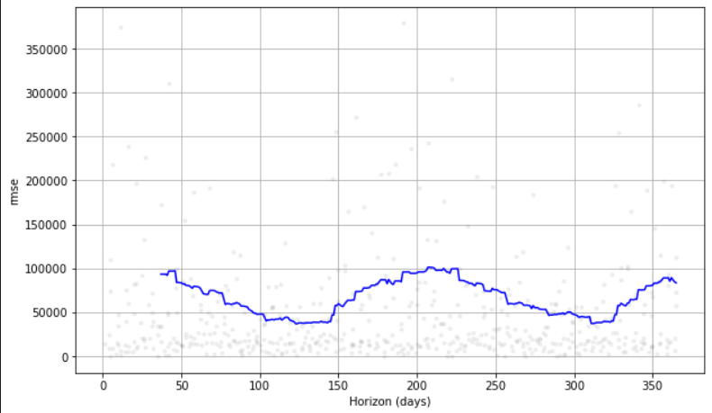
Root Mean Square Error Cross-Validation

Slide 11
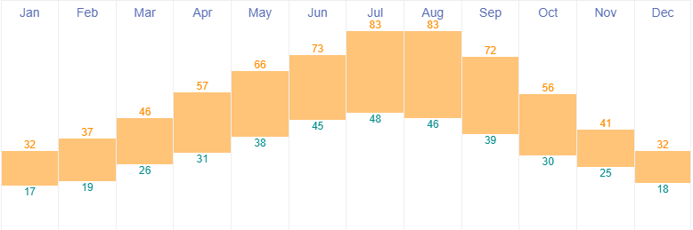
Temperature Variance of Glacier National Park

Slide 12

Conclusion
Best time to go is May, good temperature range (38-66 degrees on average) and is predicted to still be below the average number of visitors per month. Probably do early May just to avoid crowds.
However, understanding seasonal trends is important for a whole host of business scenarios (e.g. hiring seasonal workers)

Slide 13
Pain Points
Learning how to manipulate data in Python
Learning which packages need to be installed to get everything to work
Figuring out how Facebook Prophet works

Slide 14
Where to Next?
Get multiple parks that I would be interested in and find their seasonal attendance variance. Find when optimum times to visit would be. Plan family road trip.

Slide 15
Other Projects
Automating Web Scraping for Currency Rates (Power Apps, Power Automate, Sharepoint Lists)
Automotive Port Capstone (SQL, Power BI)
Habitable Planet Capstone (SQL, Power BI)

